Slide 1


HR Implementation
Onboarding/New Hire Checklist
To move through this presentation, on each slide you will click anywhere to advance to the next slide
To repeat a current slide, hover over the speaker icon and click the play button

Slide 2

Agenda
What is Onboarding
Discuss different types of items to include
Provide many examples
Review Workflows and Notifications
Next Steps
Provide link to Discovery Document to be completed

Slide 3
What is Onboarding?
Onboarding begins once a job candidate agrees to accept a job. It involves all steps needed to get a new employee successfully deployed and productive. It’s often referred to as your “New Hire Checklist.”

Slide 4
Defining your Checklists
Start with building a list of items or activities that need completed when a new employee joins your organization.
These items may need completed by HR, your employee, managers and others.
Let’s go through the list with examples.

Slide 5
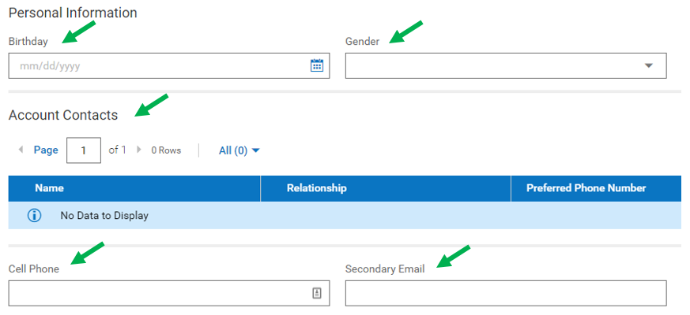
Personal Information
What information do you want the employee to enter directly into the system?
Common fields are birthday, gender, account contacts, cell phone, email.

Slide 6
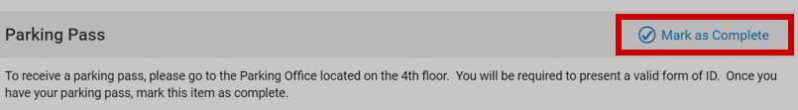
Simple Checks
This is a reminder to complete a task. The task is completed outside of the system but is tracked in the system.
What tasks need completed and by who?
Employee to pick up a parking pass
HR schedules meeting with department managers
Manager requests system access

Slide 7
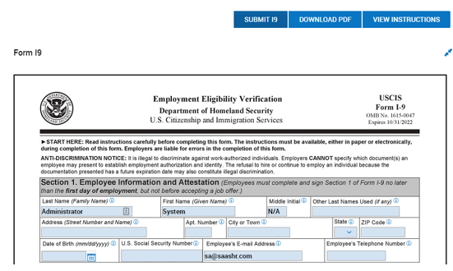
Standard Forms
There are 4 forms already included in the checklist:
I9
Federal Withholding
State Withholding
Direct Deposit

Slide 8
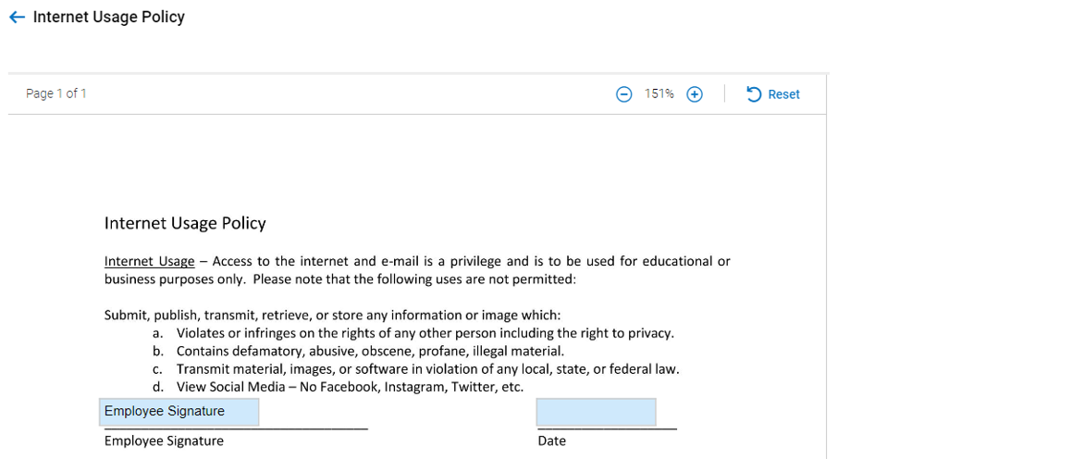
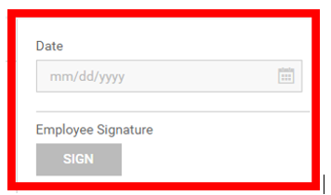
Custom Forms
Custom Forms and Policies – employee to complete/sign
Internet Usage
Drug Free Workplace
Employee Handbook Acknowledgement
PDF versions of the form will be uploaded
Input fields will be added
APS will complete 3 custom forms for you
Custom Forms Training will be provided

Slide 9
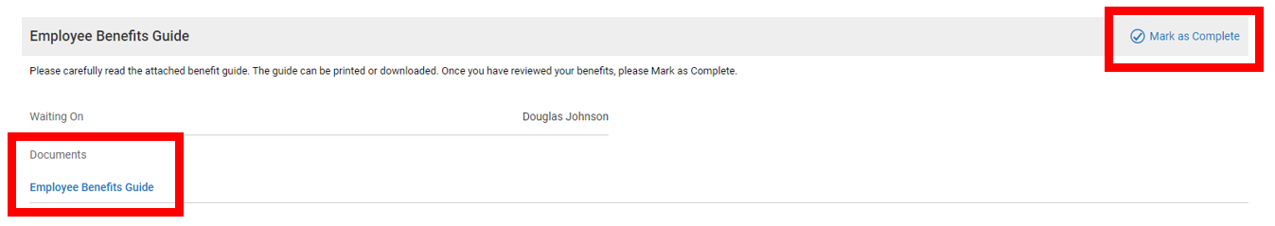
Company Documents
Documents provided to the employee – option to read/download/print
Mission Statement
Benefit Summary Guide
Employee Handbook

Slide 10
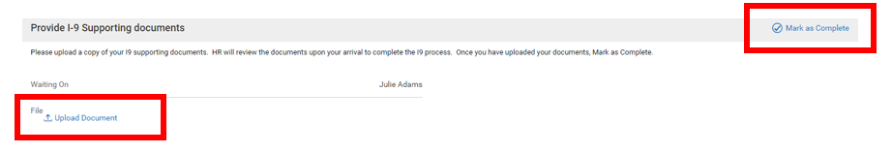
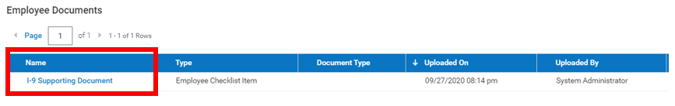
Employee Documents for Retention
Employee/HR/Manager can upload documents for retention
I9 supporting documents
Verification of bank account information
Copy of certification/license

Slide 11
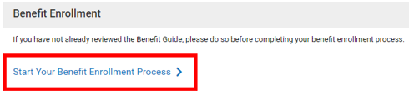
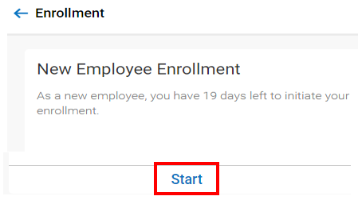
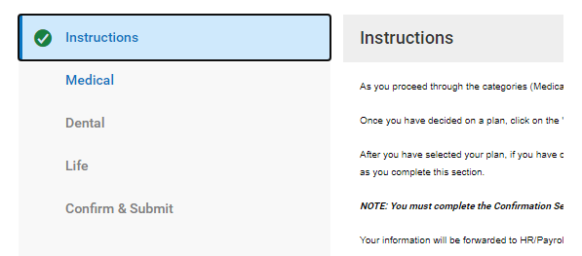
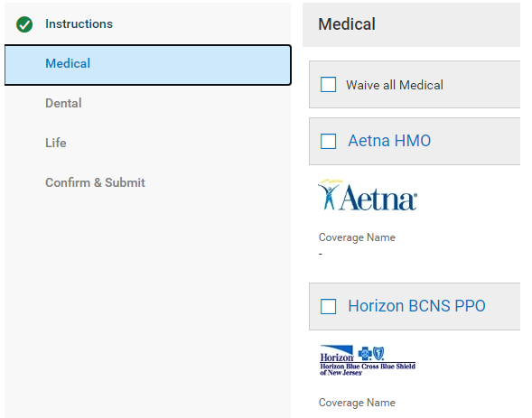
Benefit Enrollment
Include a checklist item that will initiate the Benefit Enrollment Process

Slide 12
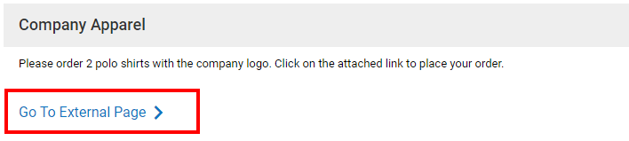
Hyperlink to other websites
Include a checklist item that will take the employee to an external website:
Order uniforms or company apparel
Schedule drug test

Slide 13
Workflows & Notifications
When should the onboarding process start?
Employee to login and start completing tasks before 1st day
Employee will complete on the 1st day
For each task, identify all parties involved and the order of completion.
Only employee completes
Employee completes and HR approves
Employee completes and manager approves
Only HR completes
To-Do Items, Checklists and Email Notifications are used to manage the checklist process.

Slide 14
Next Steps
Defining your Onboarding Checklist
Gather all documents, policies, tasks that need completed
Send electronic copies to APS ahead of time
Workflows – For each checklist item, identify each person involved in the process
Complete the Onboarding Discovery Document located on the Client Resources webpage
This will assist you in organizing the data you’ve gathered
Send the document to APS ahead of time
Meet with your APS Implementation Specialist
APS will prepare a Scope & Timeline Document

Slide 15
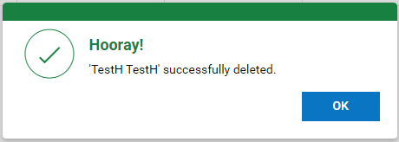
Presentation successfully completed.
We look forward to serving you!
Hit escape to end this presentation

